Slide 1


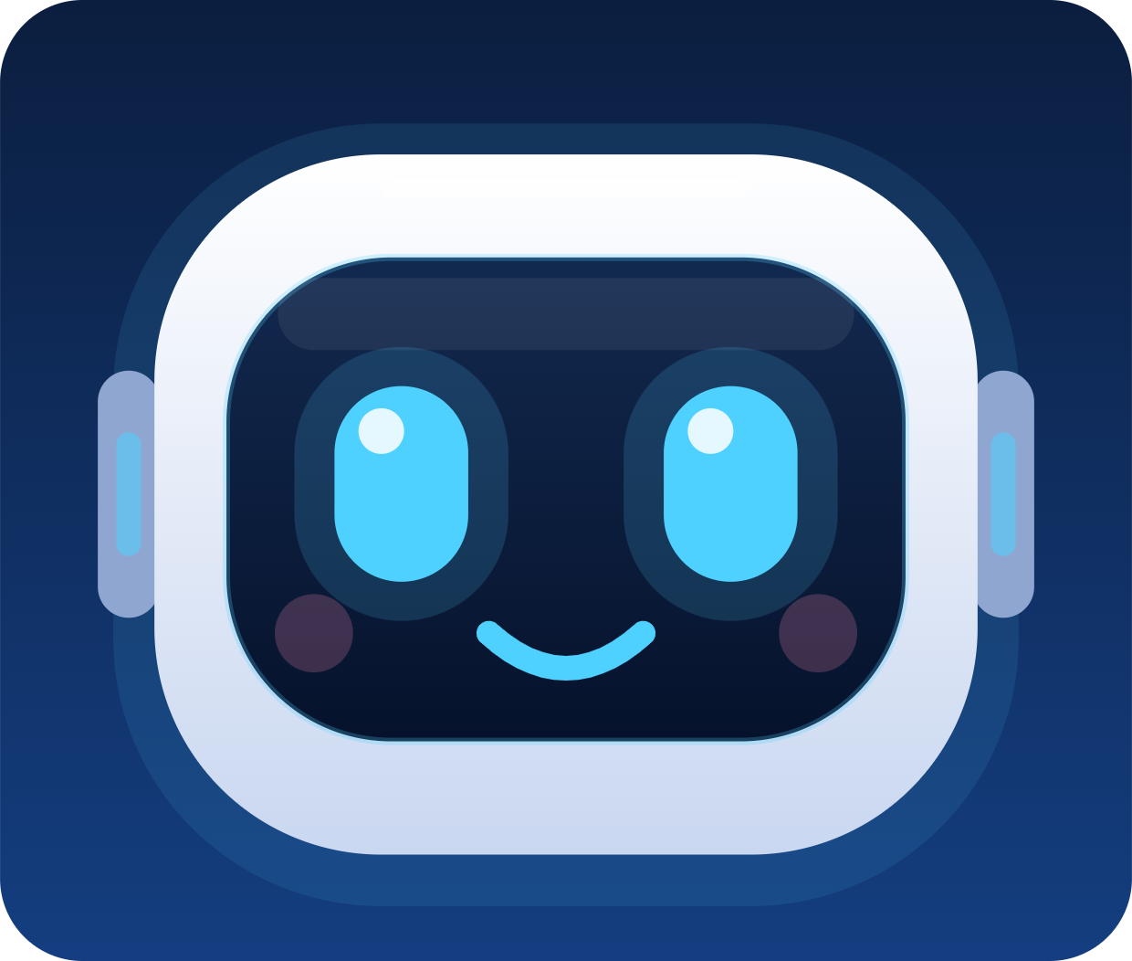
Meet Norra
PRESENTATION FOR TERRA ROBOTICS
A voice-controlled robot receptionist for Founders Foundation
Hinterland Hack project · Orionstar GreetingBot Nova
Notes:
Welcome, and thank you for having us. This is Norra, a robot receptionist that we built for Founders Foundation as part of the Hinterland Hack project. She runs on an Orionstar GreetingBot Nova. The face on this slide is the same one visitors see on the robot's screen. In the next few minutes I will show what a visitor experiences, how the system works behind the screen, what we have tested, and what we plan to build next.

Slide 2
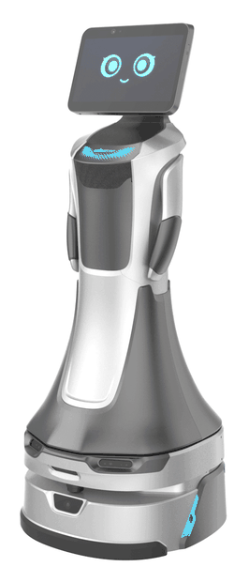



Reception work is repetitive
Visitors wait
People arrive and do not know who to ask or where to go.
Hosts are not told
A guest can sit in the lobby while the host has no idea they have arrived.
The same questions
Where is the restroom? Where do I wait? Staff are interrupted again and again.
Norra takes this work over, in German and English.
Norra · Smart Receptionist
2
Notes:
Reception looks simple, but three things go wrong in almost every office. Visitors wait without knowing what to do. The person they came to see is not told they have arrived. And staff answer the same questions all day, such as where the restroom is or where to wait. A robot at the entrance can take over all three tasks, and it can do it in two languages. The turning robot on the right is the Orionstar GreetingBot Nova that Norra runs on; the picture is from Orionstar's website.

Slide 3




Four jobs, one robot
WHAT NORRA DOES
Check in
Notify the host
Appointments, walk-ins, bookings and deliveries, by voice or by touching the screen.
Sends the employee an email as soon as the visitor has checked in.
Print a badge
Guide and entertain
Prints a badge with name, host and QR code for guests with an appointment. The photo is optional.
Walks visitors to the restroom or waiting room and tells a short story while they wait.
Norra · Smart Receptionist
3
Notes:
Norra has four jobs. First, she checks visitors in by voice or by touching the screen. She welcomes them and asks how she can help. For an appointment she asks for the name and the host. For a walk-in the backend checks the host's calendar, and Norra offers to walk the visitor to the waiting room; if the host is not free today she offers a booking. For a booking she suggests free slots and creates the calendar event. For a delivery she records the carrier, asks about a signature and tells the recipient; a photo of the package is optional and off by default, and a reminder follows if it is not collected. Second, she notifies the host by email. Third, for guests with an appointment she prints a visitor badge with the visitor's name, the host and a QR code; the photo on it is optional and only taken with the visitor's consent. The email to the host needs the SMTP settings; without them the backend only simulates the message. Fourth, she guides and entertains. After check-in she walks the visitor to the waiting room. If the visitor asks for another place on the way, for example the restroom, she makes that stop first, waits a few seconds and then resumes the original walk. The destinations are not typed in by hand: the Admin screen loads them from the map saved on the robot, and the visitor can stop the walk at any time by saying stop or by tapping the screen. While a visitor waits, she offers a short story about Founders Foundation; it is offered first, never forced, and can be stopped at any moment. Languages: visitors can tap DE or EN, and Norra also detects the language from what the visitor says and answers in it; after 45 seconds of inactivity she goes back to the default language. To understand speech, the robot's own language model reads each sentence and pulls out the name, the host or the request; if the model is unavailable, simple keyword rules take over, so check-in still works. Free chat: if a visitor says something unrelated to check-in, Norra answers in one or two short sentences and then asks her first question again. She is instructed to use only facts from the Founders Foundation story text and to say so when she does not know. That is an instruction to the language model, so the answers are not guaranteed to be perfect, and free chat only works at the first question. The story and the chat can both be switched off in the Admin screen, and the story text can be replaced with your own.

Slide 4
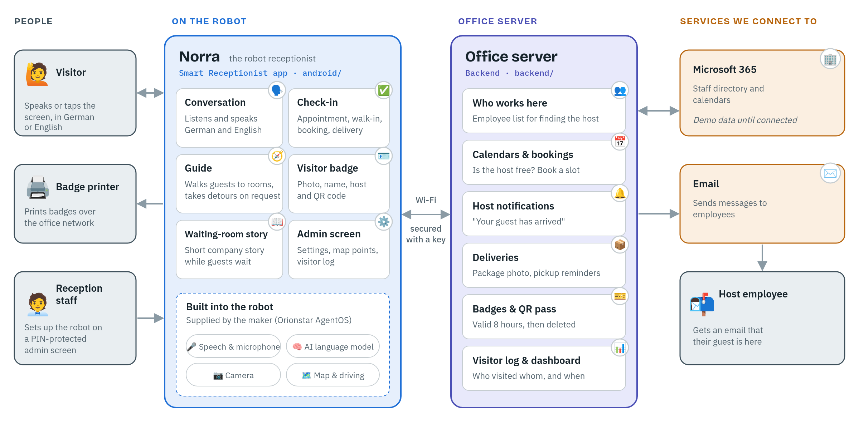
The big picture
Norra · Smart Receptionist
4
Notes:
This diagram shows the whole system, read from left to right. On the far left are the people and devices in the building: the visitor, who speaks or taps the screen in German or English; the badge printer on the office network; and the reception staff, who set up the robot on a PIN-protected admin screen. Next is Norra, the robot, running our Android app. The app handles the conversation, check-in, guiding, the visitor badge, the waiting-room story and the admin screen. It relies on features that are built into the robot by its maker: speech and microphone, the AI language model, the camera, and the map and driving. The robot talks over Wi-Fi to our office server, secured with a key. The server holds the staff list, calendars and bookings, host notifications, deliveries, badges and QR pass, and the visitor log. The server in turn connects to the company services: Microsoft 365 for the staff directory and calendars, which runs on demo data until it is connected, and email, which sends the host a message that their guest has arrived.

Slide 5
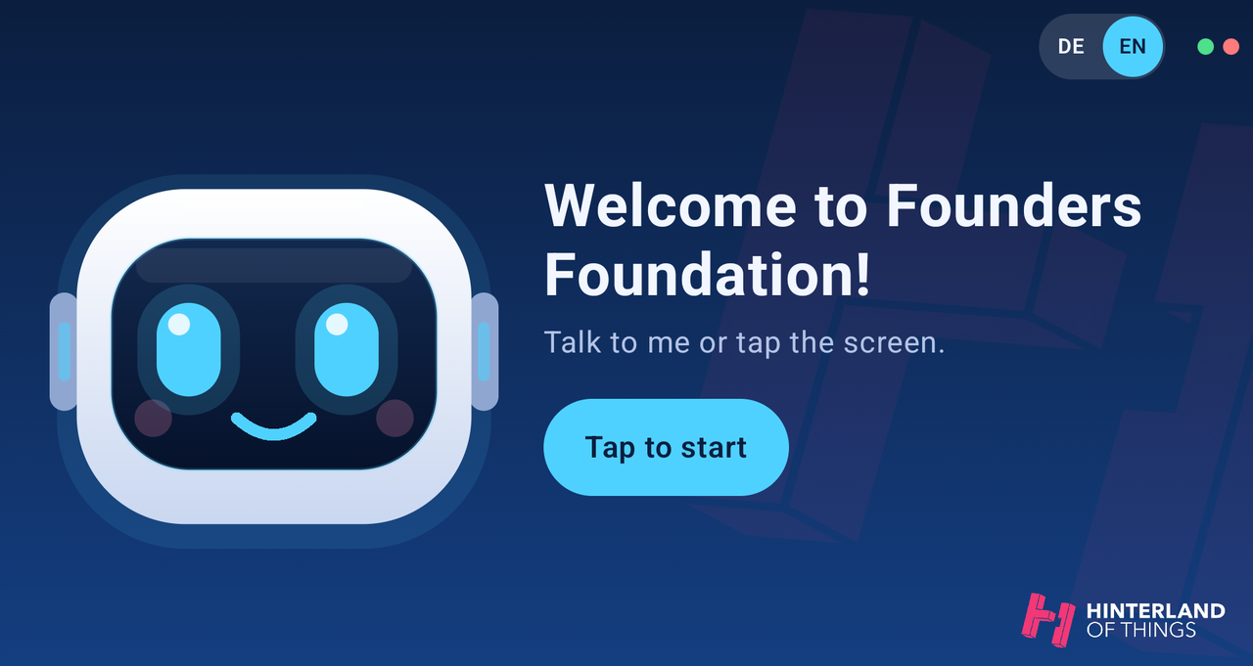
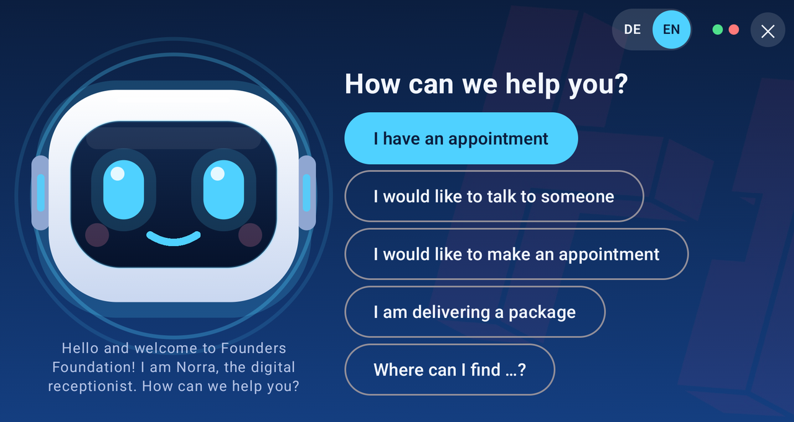
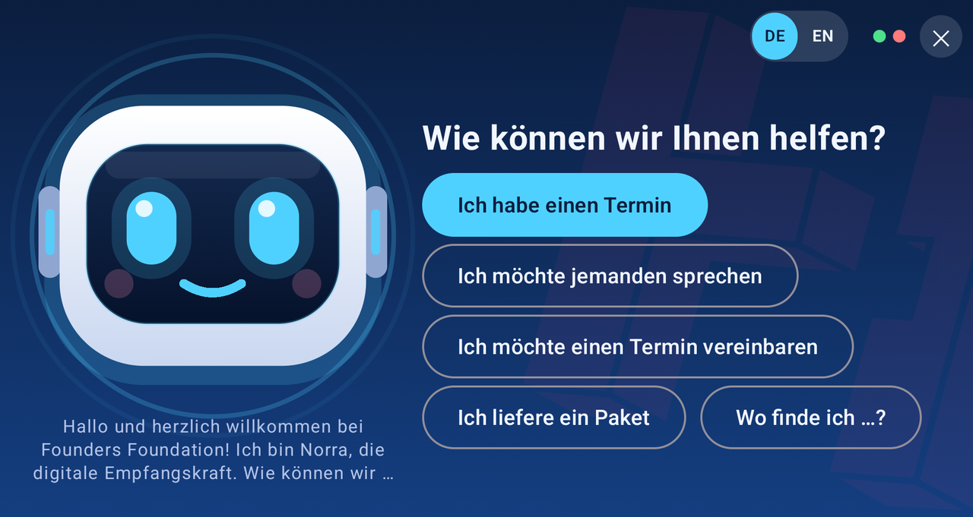
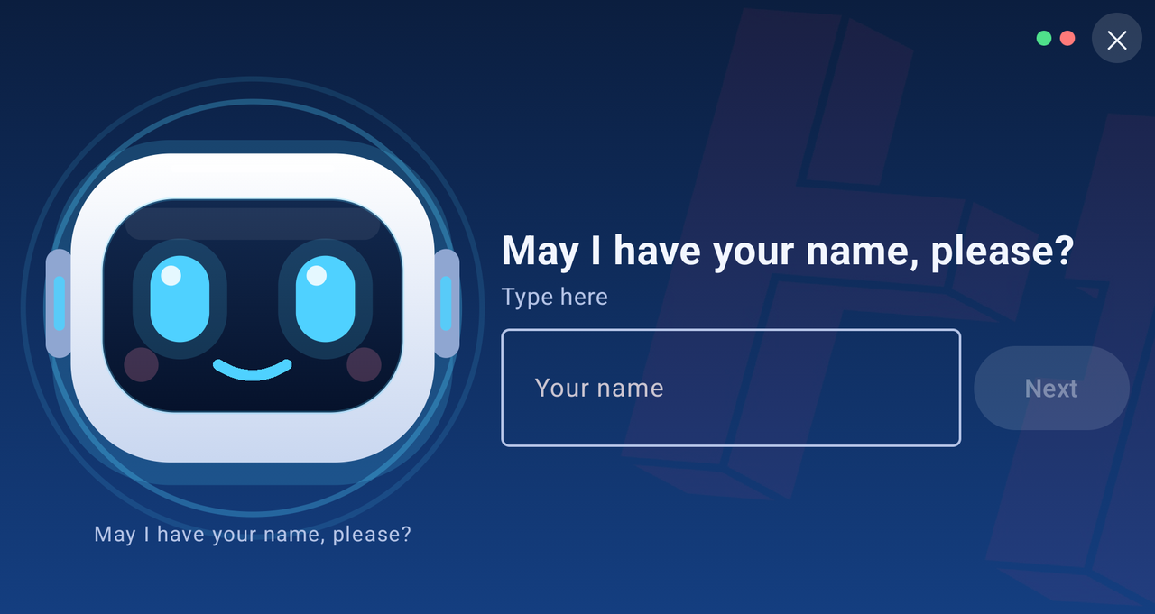
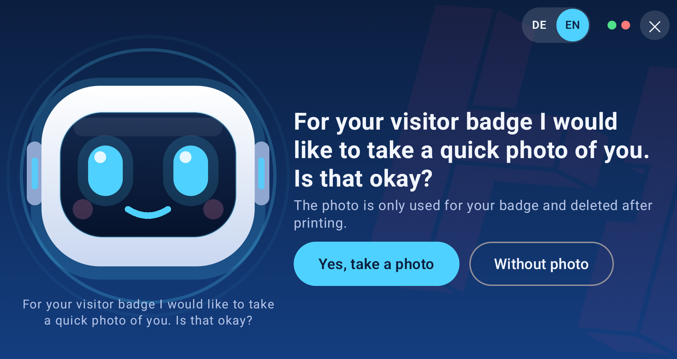
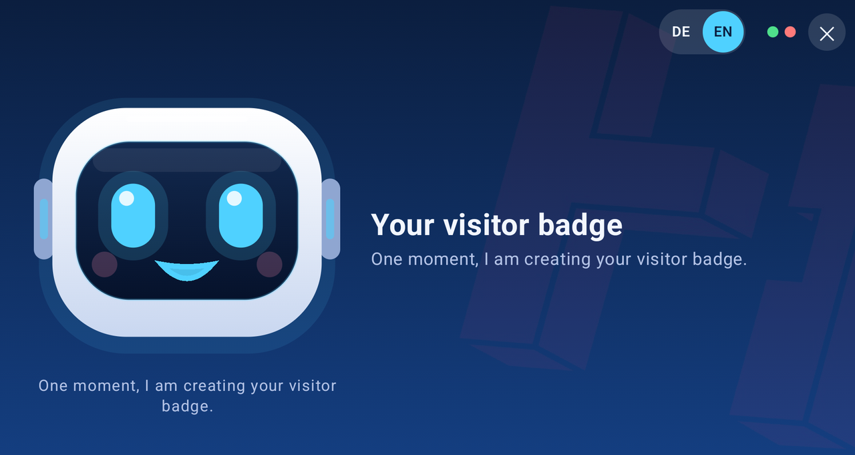
What visitors see
Start screen
First question
The same question in German
Check-in: the visitor’s name
Photo only with consent
The badge is created
Norra · Smart Receptionist · screenshots from the Android emulator
5
Notes:
This is the real app. The top row shows the start screen with Norra's face, the welcome to Founders Foundation and a button to begin; visitors can also simply talk to her. Next is the first question with five buttons: I have an appointment, I would like to talk to someone, I would like to make an appointment, I am delivering a package, and Where can I find. The third picture is the same question in German after the visitor tapped DE; the small DE and EN switch is in the top right corner. The bottom row shows a check-in for a guest with an appointment. First Norra asks for the name; the visitor can speak or type it. After the host has been told, she asks whether she may take a photo for the badge, and says that the photo is only used for the badge and deleted after printing. The visitor can answer without a photo. Then she creates the visitor badge. These screenshots come from the Android emulator, where the camera and printer are not available, so this run created and reported the badge without a photo and without a real printout. The same run notified the host: the email appeared in the simulated inbox because the demo backend does not send real emails.

Slide 6
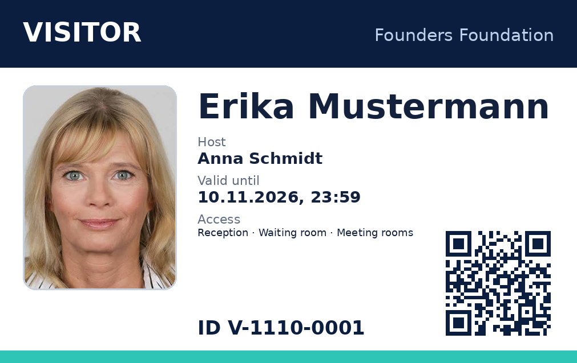
The visitor badge with a QR code
SECURITY
On the badge
Name, host and badge ID
Valid until, at most midnight
Access zones
Optional photo
The QR code
Opens a page that shows if the badge is valid
Every scan is logged
Door readers can check a zone
Data is deleted after the visit
Norra · Smart Receptionist
6
Notes:
For security, guests with an appointment get a visitor badge. It shows the visitor's name, the host, the badge ID, the access zones and when it expires. By default a badge is valid for eight hours and never beyond midnight, and the photo is optional. The QR code on the badge opens a page on our backend that shows whether the badge is valid and logs every scan. A door reader can ask the backend whether this badge may enter a given zone, such as reception or the meeting rooms. When the badge expires or the visit ends, the backend deletes the data, and the photo is never stored at all; it only exists on the printout. The badge in this slide was generated by the backend with demo data: the name is a placeholder, the photo is a sample picture, and the QR code is a placeholder. One limit: a visitor's phone can only open the QR code page if the backend has a public web address, which is part of our next step.

Slide 7


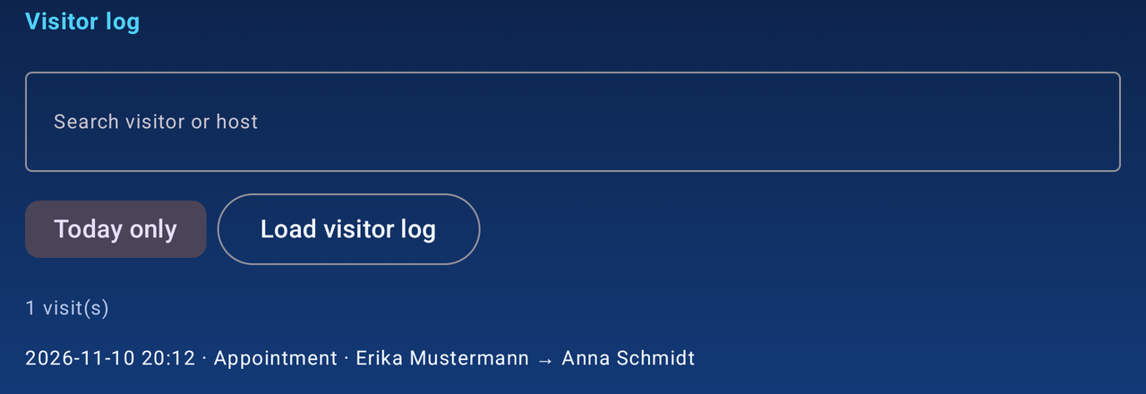
Admin screen and visitor log
FOR STAFF
Admin screen
Visitor log
Opened by a long press in the top-left corner, then a PIN.
Saved to a file on the backend, so it survives a restart. Search by visitor or host, today or all days.
Backend address and printer
Map points, loaded from the robot
Language, robot name, company name
Switches for chat and story
Norra · Smart Receptionist
7
Notes:
Staff manage the robot from a hidden Admin screen on the robot itself: long-press the top-left corner and enter a PIN. There they set the backend address, the printer, the language, the robot and company name, and switch features on or off. The map points are loaded from the robot's saved map into drop-down lists, so nobody has to type names. The same screen shows the visitor log: who came, when, to see whom, with search and a today-only filter. The screenshot shows one demo visit. The log is saved by the backend to a file, so it is not lost when the server restarts. Departure times are not recorded yet, because check-out is still on our roadmap.

Slide 8

How it is built and delivered
UNDER THE HOOD
Robot app
Office server
Tested
Kotlin and Jetpack Compose
Python and FastAPI
Automatic tests
Uses the robot’s AgentOS for speech and its RobotAPI for the map and driving.
Microsoft 365 through Graph, email through SMTP, secured by an API key.
The app’s tests run on every build.
From code to robot
1
2
3
4
Code on GitHub
Automatic build
Download link
On the robot
One shared repository.
Tests and the app are built on every change.
A fixed link always has the newest version.
Installed by staff; the app can also check for updates.
Norra · Smart Receptionist
8
Notes:
The robot app is written in Kotlin with Jetpack Compose. It uses the robot's own AgentOS for speech and the language model, and the RobotAPI for the map and for driving. The office server is written in Python with FastAPI; it talks to Microsoft 365 through Graph and sends email over SMTP, and it is protected by an API key. The code has automated tests, and the app's tests run automatically on every build. Delivery is automatic too. The code lives in one GitHub repository. Every change triggers a build that runs the tests and builds the app, and a fixed download link always points to the newest version. Staff install it on the robot, and the app can also check for updates itself. For now the office server runs on a laptop in the office. It can also run in the cloud on Render, but the free plan wipes the badges and the visitor log on every update, so real use would need a paid plan with storage.

Slide 9
Digital pass and check-out
NEXT
1
A public address for the backend, so visitors’ phones can open the QR code
2
A digital pass on the visitor’s phone: a QR code on the robot’s screen, and a PDF download
3
Check-out by scan or tap, with the departure time shown in the visitor log
4
Faster host alerts, for example in Teams or Slack
Open decision: should the digital pass replace the printed badge, or come in addition to it?
Norra · Smart Receptionist
9
Notes:
Our next task is a digital pass and check-out. Visitors' phones can only open the QR code if the backend has a public web address, so that comes first. For the event we can use a free tunnel from the laptop, and later a hosted server with proper storage. Then the visitor gets a digital pass on their phone with a PDF download, and checking out by scan or tap records the departure time in the visitor log. We also want faster alerts for hosts, such as a Teams or Slack message. One decision is still open: whether the digital pass should replace the printed badge or come in addition to it.

Slide 10
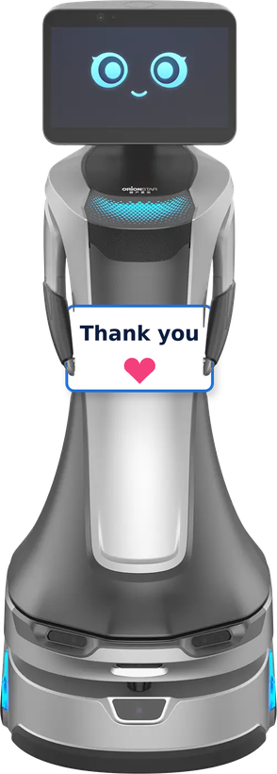
Thank you
NORRA · SMART RECEPTIONIST
Questions and ideas are welcome.
Founders Foundation · Hinterland Hack · Terra Robotics
Notes:
Thank you for listening. I am happy to answer questions, and to show the app running. The robot on the right is the Orionstar GreetingBot Nova; the picture is from Orionstar's website, with a thank-you card added.

